Slide 1
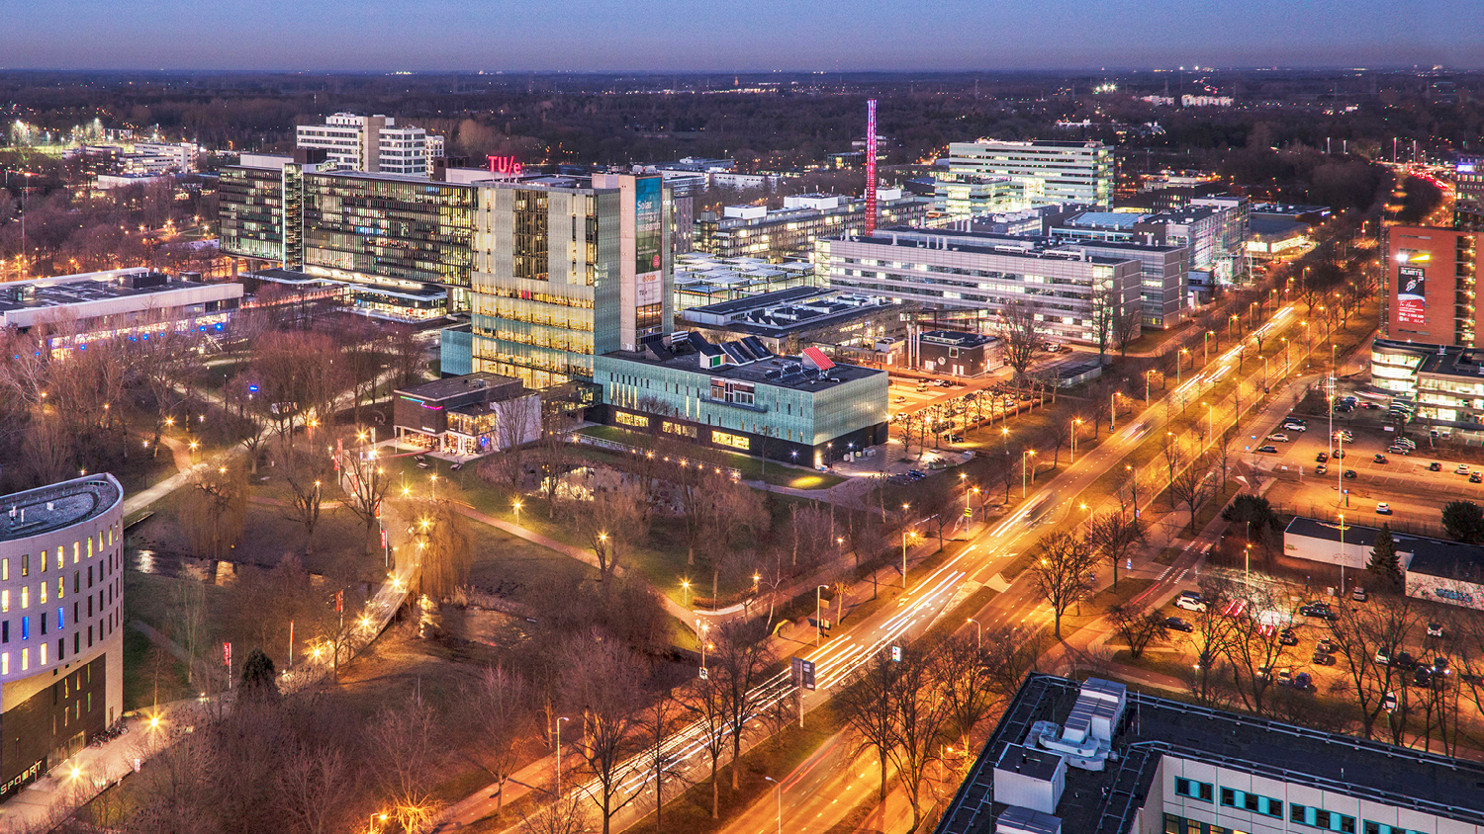

Web-based BIM
BILT Academy, 22-04-2025
Alex Donkers, Postdoctoral researcher
Information Systems in the Built Environment, Department of the Built Environment

Slide 2
👋Hi, I’m Alex
BSc Architecture, Urbanism & Building Sciences
Building a smart & sustainable home in Dubai
MSc cum laude Construction Management & Engineering
PhD cum laude Information Systems in the Built Environment
Postdoc Eureka ITEA4 FireBIM
Research at Universiteit van Witwatersrand and
Ruhr Universiteit Bochum
W3C Linked Building Data CG and LDAC
https://research.tue.nl/nl/persons/alex-ja-donkers

Slide 3
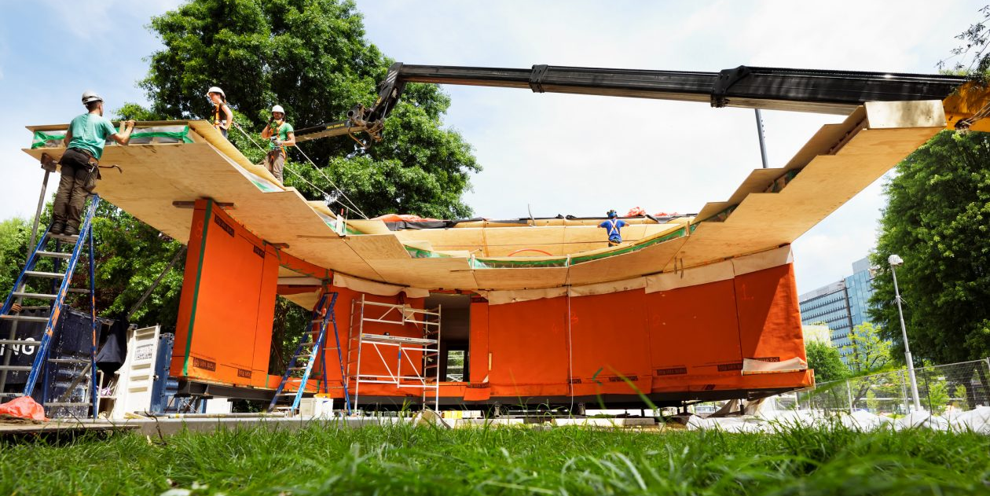

Slide 4
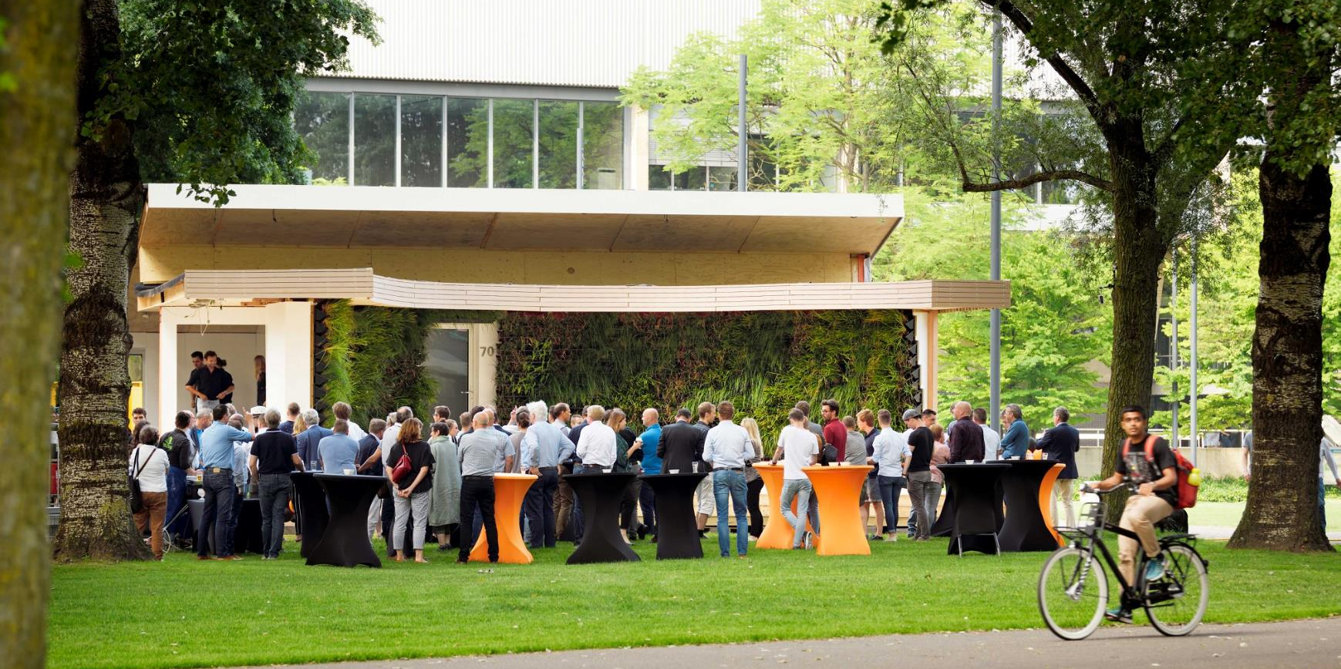

Slide 5


Slide 6
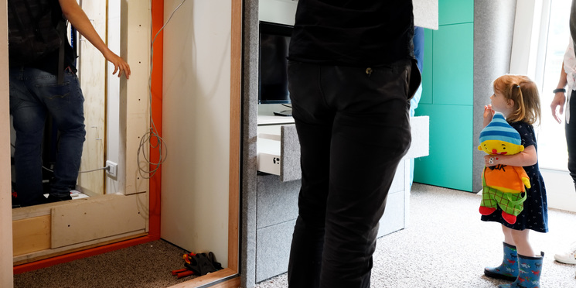

Slide 7
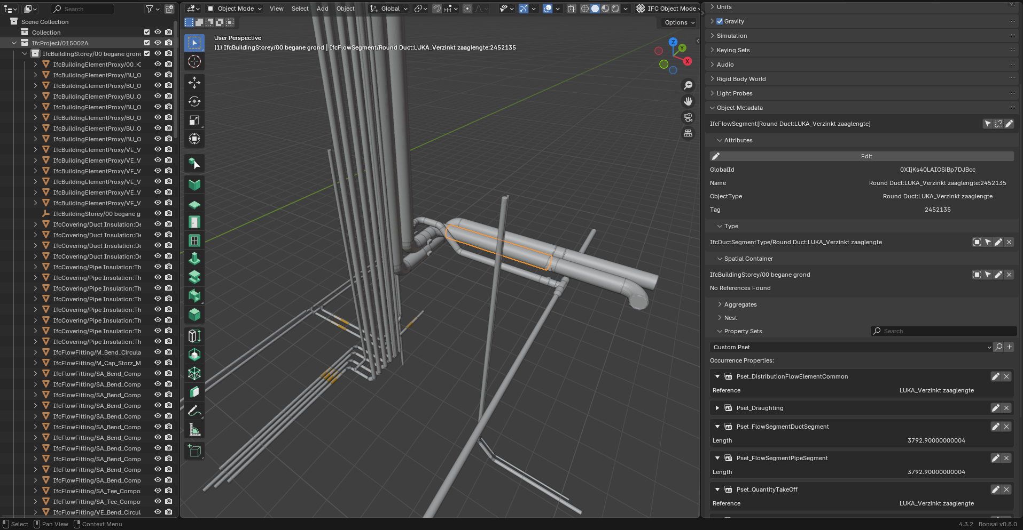

Slide 8
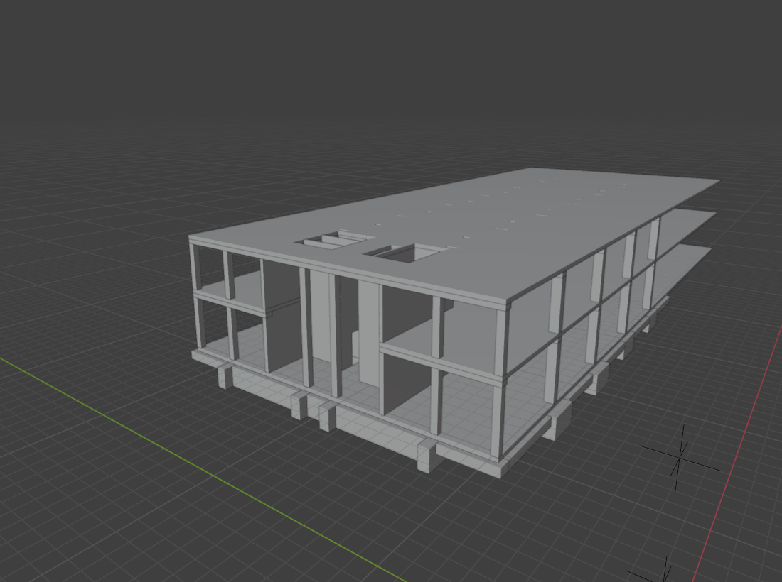
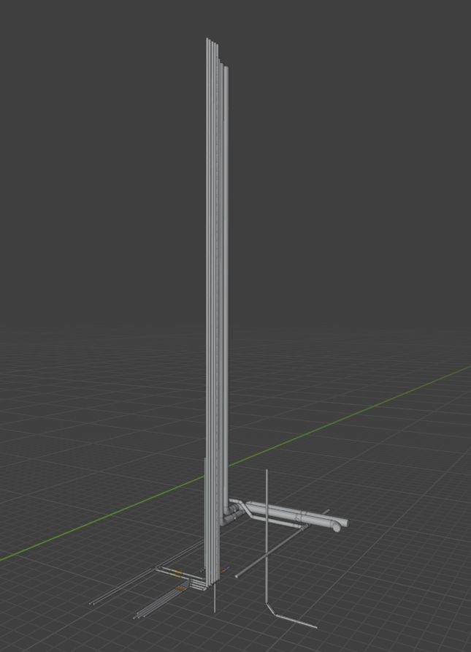
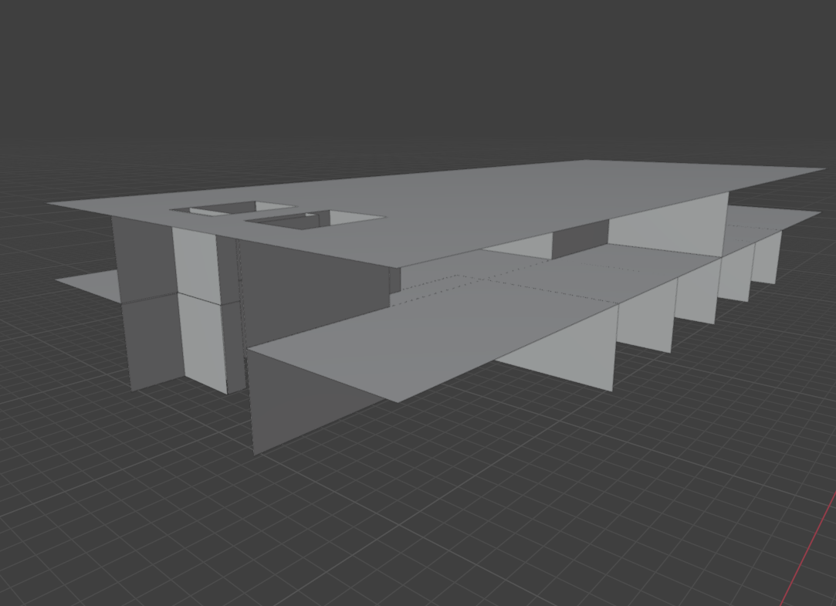
Our industry has a fragmented nature
BIM models are being developed by different disciplines

Slide 9
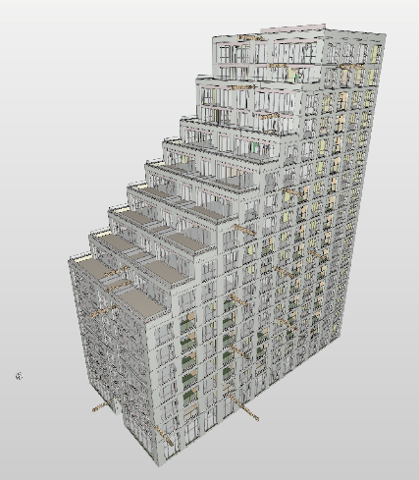

Integration?
These IFC models are just separate models in the same
Coordinate system. How integrated are they?

Slide 10
Data silos
The data in those files is still siloed.

Slide 11
Outline
Block 1
The Semantic Web and Linked Building Data
Block 2
Ontologies
Block 3
Interaction

Slide 12
The Semantic Web

Slide 13

The World Wide Web

Slide 14
A whole lot of data exists on the WWW

Slide 15
The WWW integrates data into web pages (HTML)

Slide 16
Hyperlinks allow us to go to other pages (URL)

Slide 17
This is great for humans!

Slide 18

… but machines can’t interpret the WWW
What is that image showing me?
What do those links mean?

Slide 19
The Semantic Web
“The Semantic Web is an extension of the current web in which information is given well-defined meaning, better enabling computers and people to work in cooperation.”
Tim Berners-Lee et al. 2001.
Description language with standard semantics
Make semantics machine-understandable
Incorporate logical infrastructure so that machines can reason about resources

Slide 20
Making data machine-understandable
Atlas
Vertigo
Building
has name
has name
Building
is a
is a
location
location
architect
Eindhoven
born in
John Doe
appears in
has name
TU/e promo video
Video
is a

Slide 21
Web of Data

Slide 22
Core differences
 | World Wide Web | Semantic Web/Web of Data
Analogy | Global file system | Global database
Designed for | Human consumption | Machines first, humans later
Primary objects | Documents | Things or descriptions of things
Links between | Documents | Things
Semantics | Implicit | Explicit

Slide 23
The information model Resource Description Framework (RDF)
RDF is a standard graph data model used to describe things and their interrelations. RDF is based on a triple model: subject – predicate – object.
RDF graphs are directed labelled graphs.
Both machines and humans can interpret RDF.
RDF triples can be seen as arcs of a graph (vertex, edge, vertex).
subject
predicate
object
Vertigo
Eindhoven
is located in

Slide 24
Multiple RDF triples form a graph
Atlas
is located in
Vertigo
Eindhoven
is located in
architect
John Doe

Slide 25
Identifiers Uniform Resource Identifiers (URIs)
All information in the Semantic Web is represented using URIs.
Thanks to those URIs, we know which specific objects we’re talking about.
https://www.rijksoverheid.nl/cities#Eindhoven
https://www.example.org#isLocatedIn
https://www.tue.nl/buildings#Vertigo
https://www.example.org#architect
https://www.linkedin.com/in/JohnDoe

Slide 26
URIs and literals
In a triple (subject – predicate – object), the subject and predicate are always URIs! An object can be a URI or a literal. A literal can be a string, a Boolean, an integer, a double, etc. Literals have no outgoing links!
https://www.rijksoverheid.nl/cities#Eindhoven
https://www.example.org#isLocatedIn
https://www.tue.nl/buildings#Vertigo
https://www.example.org#name
“Vertigo”

Slide 27
Prefixes
To make things a bit more human readable, we can replace parts of the URI by a prefix. Machines still understand that these are URIs.
https://www.tue.nl/buildings#Vertigo > tue:Vertigo
cities:Eindhoven
ex:isLocatedIn
tue:Vertigo
ex:architect
people:JohnDoe

Slide 28
Syntax Various notation styles exist
There are multiple ways to serialize data on the semantic web, such as:
Turtle (TTL, Terse RDF Triple Language)
JSON-LD
RDF-XML
As Turtle files are the easiest to read by humans, we’ll mostly use those in this course.

Slide 29
An RDF graph in TTL
@prefix ex: <https://www.example.org#>
@prefix tue: <https://www.tue.nl/buildings#>
@prefix cities: <https://www.rijksoverheid.nl/cities#>
@prefix people: <https://www.linkedin.com/in/>
tue:Vertigo
ex:name “Vertigo” ;
ex:architect people:JohnDoe ;
ex:isLocatedIn cities:Eindhoven .
cities:Eindhoven
ex:name “Eindhoven” .
people:JohnDoe
ex:name “John Doe” ;
people:hasColleague <https://www.linkedin.com/in/JaneDoe> .

Slide 30
Graphs can be interconnected using URIs
“Vertigo”
“Eindhoven”
ex:name
ex:name
tue:Vertigo
ex:isLocatedIn
cities:Eindhoven
tue:Vertigo
ex:architect
people:JohnDoe
ex:name
“John Doe”
people:hasColleague
people:JaneDoe

Slide 31
Graphs can be interconnected using URIs
“Vertigo”
“Eindhoven”
ex:name
ex:name
ex:isLocatedIn
cities:Eindhoven
tue:Vertigo
tue:Vertigo
tue:Vertigo
ex:architect
people:JohnDoe
ex:name
“John Doe”
people:hasColleague
people:JaneDoe

Slide 32
@prefix ex: <https://www.example.org#>
@prefix tue: <https://www.tue.nl/buildings#>
@prefix cities: <https://www.rijksoverheid.nl/cities#>
tue:Vertigo
ex:name “Vertigo” ;
ex:isLocatedIn cities:Eindhoven .
cities:Eindhoven
ex:name “Eindhoven” .
@prefix ex: <https://www.example.org#>
@prefix tue: <https://www.tue.nl/buildings#>
@prefix people: <https://www.linkedin.com/in/>
tue:Vertigo
ex:architect people:JohnDoe .
people:JohnDoe
ex:name “John Doe” ;
people:hasColleague <https://www.linkedin.com/in/JaneDoe> .

Slide 33
Linked Building Data

Slide 34


Data integration is now possible
Scale levels:
MyBuilding.ttl
MyCity.ttl
Disciplines:
ArchitecturalDesign.ttl
StructuralDesign.ttl
Information types:
BIM.ttl
SensorData.ttl

Slide 35
Linked Data
Four principles:
Things are names by URIs
Things could be looked up by people using HTTP URIs
Things provide useful information (using RDF*, SPARQL)
Thinks include links to other URIs

Slide 36
Linked Open Data
5-star Linked Open Data
⭐ Dara is available on the web as open data
⭐⭐ Data is structured as machine readable (e.g. Excel)
⭐⭐⭐ Data is structured in a non-proprietary format (CSV)
⭐⭐⭐⭐ Data is structured as RDF
⭐⭐⭐⭐⭐ Data links to other data to provide context
Please understand that Linked Data is not necessarily open data!

Slide 37
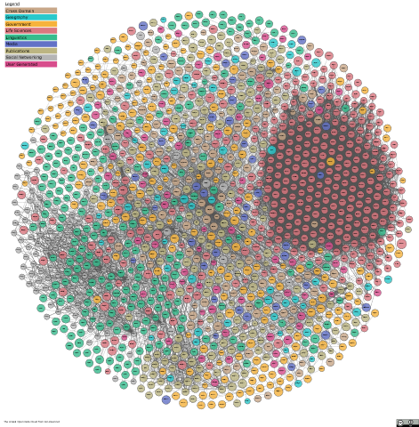
lod-cloud.net
Linked open data is happening in multiple domains, and links are being created within domains as well as cross-domain.
Datasets in 2024: 1349

Slide 38
A whole lot of data exists about buildings
 | Paper-based | Digital drawings, text, tables | Data streams | Semantically rich data
Format | Paper | .pdf, .doc, .exc | IoT data streams | .ifc, .ttl
Examples | Construction specification drawing, time schedules | CAD drawings, product specifications, cost schedules | Temperature sensor data, system logs | BIM models, graph-based building information, ontologies
Semantics | Implicit | Implicit | Just some labels | Explicit
Characteristics | Quick to produce, low learning curve, traditions of knowledge, no information management | Higher learning curve, traditions of knowledge, enables information sharing through computers | High velocity & volume & variation, limited standardization, company-specific naming conventions | Standardization, long debates on the meaning of things, complex and brittle, machine-understandable, rule-based and logic-based technologies

Slide 39
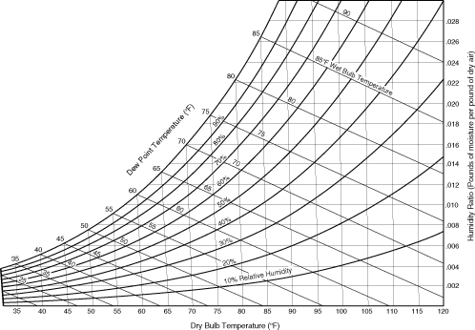
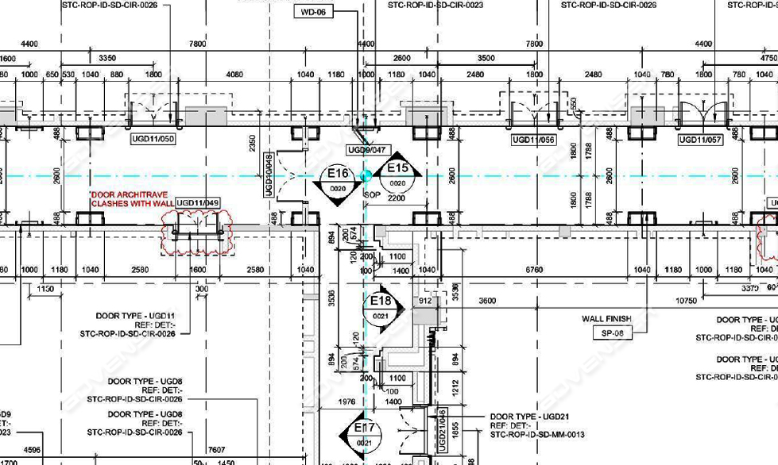
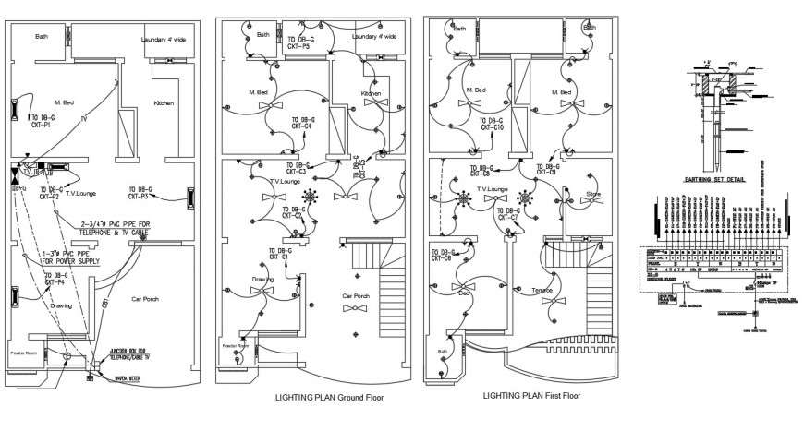
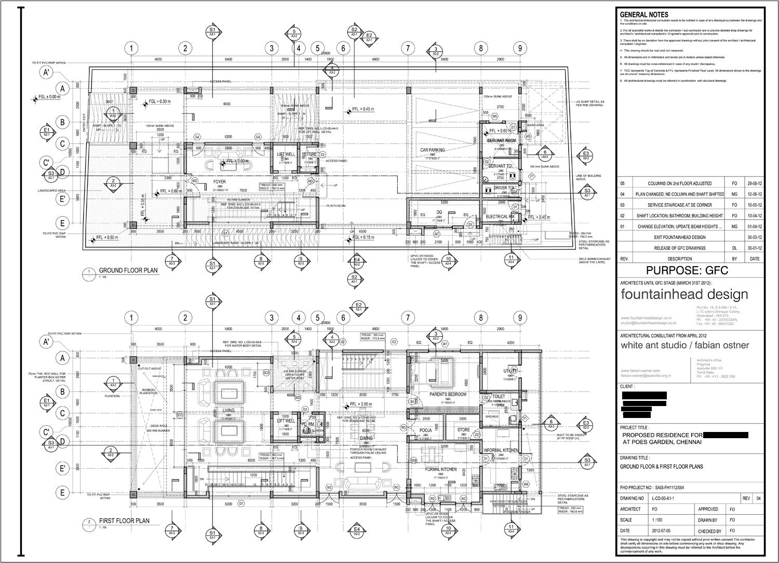
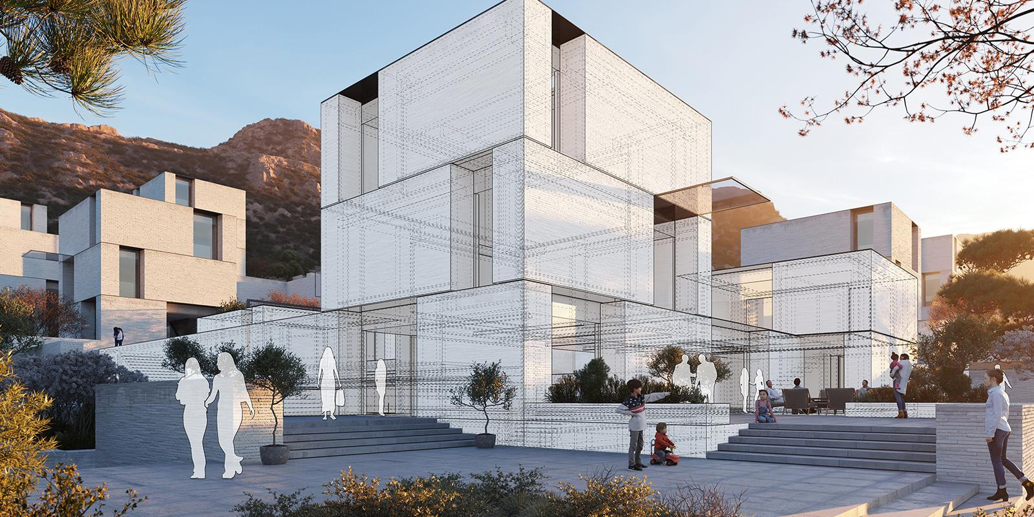
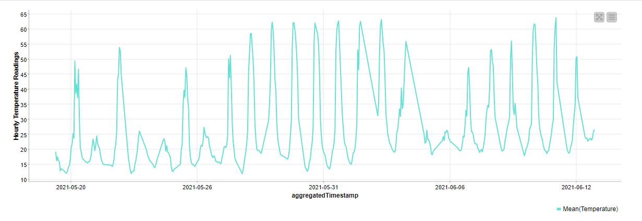
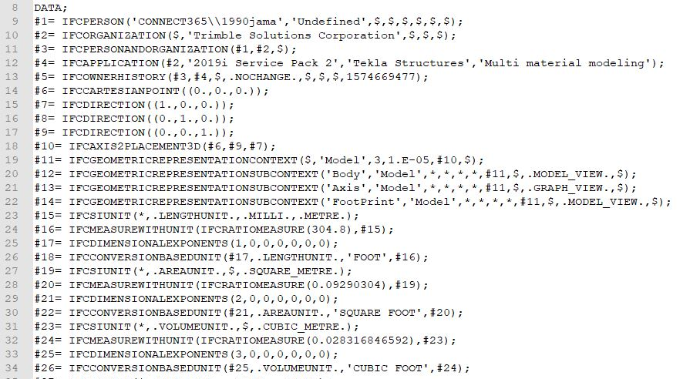
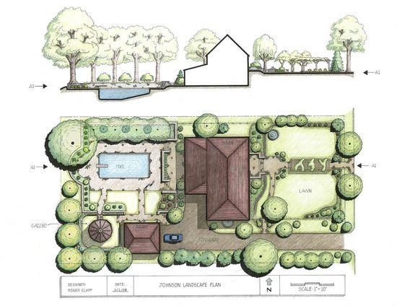
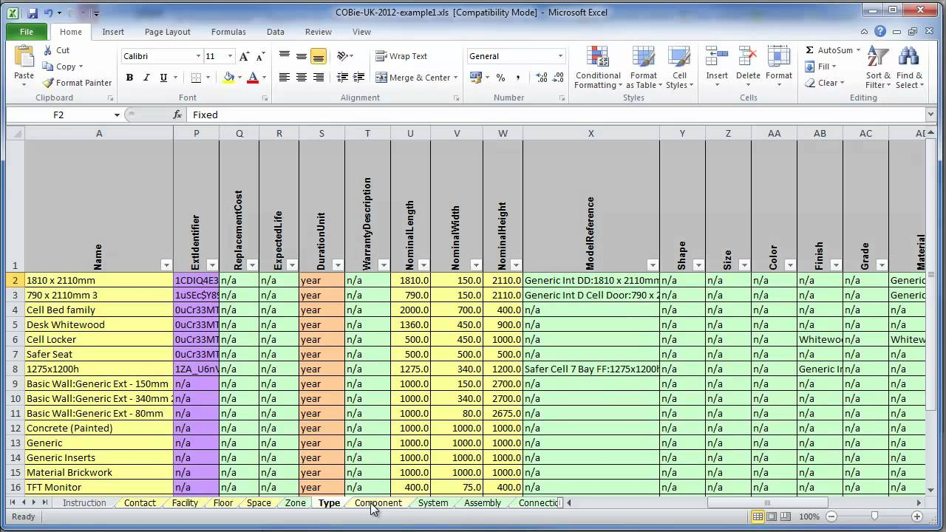
A whole lot of data exists about buildings

Slide 40
A whole lot of data exists about buildings
Like in the WWW, we give machines more information to enable reasoning.
What is that image showing me?
How is it linked to that other image?

Slide 41
Creating linked building data
inst:Site1
bop:hasProperty
inst4:EindhovenTemperature
bot:hasBuilding
bop:observedBy
inst:Appartment1
inst3:LivingRoomTemp
inst4:TemperatureSensor_02
bot:hasSpace
bop:hasProperty
bop:observedBy
inst:LivingRoom
inst3:TemperatureSensor_01
inst2:Brick
bot:adjacentElement
bop:hosts
ex:hasMaterialProperty
inst:…
ex:hasMaterial
inst:Wall_01

Slide 42
The input data can be created by different people…
Architect
Municipality
inst:Site1
bop:hasProperty
inst4:EindhovenTemperature
bot:hasBuilding
bop:observedBy
HVAC engineer
inst:MyHouse
inst3:LivingRoomTemp
inst4:TemperatureSensor_02
bot:hasSpace
bop:hasProperty
bop:observedBy
Material supplier
inst:LivingRoom
inst3:TemperatureSensor_01
inst2:Brick
bot:adjacentElement
bop:hosts
ex:hasMaterialProperty
inst:…
ex:hasMaterial
inst:Wall_01

Slide 43
… and exist in different formats
SQL database
IFC
PDF
inst:Site1
bop:hasProperty
inst4:EindhovenTemperature
bot:hasBuilding
bop:observedBy
PDF
inst:MyHouse
inst3:LivingRoomTemp
inst4:TemperatureSensor_02
bot:hasSpace
bop:hasProperty
bop:observedBy
Time series database
Excel
inst:LivingRoom
inst3:TemperatureSensor_01
Sticky notes
inst2:Brick
bot:adjacentElement
bop:hosts
ex:hasMaterialProperty
inst:…
ex:hasMaterial
inst:Wall_01

Slide 44
Linked Building Data
Enables linking of files between stakeholders, databases, lifecycle phases and software tools.
Enables machines to understand those links.
Enables linking to non-building information, which is needed for digital twins.
Please note that RDF graphs and non-RDF files coexist.
Parts of the non-RDF files can be converted to RDF graphs, so that we can semantically represent buildings, spaces, elements, locations, properties, …, in a machine-understandable form.

Slide 45
Web-based BIM

Slide 46
buildingSmart technical roadmap: move to the web!
Bespoke, high threshold
Generic, scalable, higher adoption
Standards
mvdXML
IDM
IFC
IFC
BCF
bcfAPI
Technology
STEP/
EXPRESS
UML
XML
Linked Data
JSON
Services
IfcDOC
bSDD
bSDD
GitHub
APIs

Slide 47
BIM levels
Level 0
Level 1
Level 2
Level 3
CAD
2D BIM
3D BIM
Federated BIM
Integrated BIM
Semantics
Ontologies
bSDD
ICDD
Semantics
Proprietary formats
Proprietary formats and domain-specific methods and standards
International standards (ISO)
IFC
IDM
IFD
Standards
Drawings
Geometric models
Domain-specific models:
Architectural, structural, HVAC, asset management
Integrated, interoperable models
Information
Paper
Files
Central management of files in Common Data Environments
Cloud-based information and coordination
Collaboration
1990s
2000s
2010s
2020s

Slide 48
Web-based BIM?
“A web-based BIM platform is a streamlined diverse system that combines different applications to interact with each other.” (Amoah, 2022)
“BIM itself is moving towards Level 3, which is web-based and data-driven, as opposed to the file-based BIM of today.” (Chamari et al., 2022)
“[…] unifying BIM data representation based on both AEC industry standard i.e. IFC and Web compatible data format i.e. JSON. The standardization of Web compatible BIM data can expedite the production and revision of construction documents.” (Afsari et al., 2017)

Slide 49
Web-based BIM
Enables web-based data-transfer methods
Enables integration with other industries using web-based methods
Enables software developers to build web-based applications on top of our BIM data
Enables integration with IoT data streams
Enables reuse of already developed web-based protocols, e.g. related to security and privacy

Slide 50
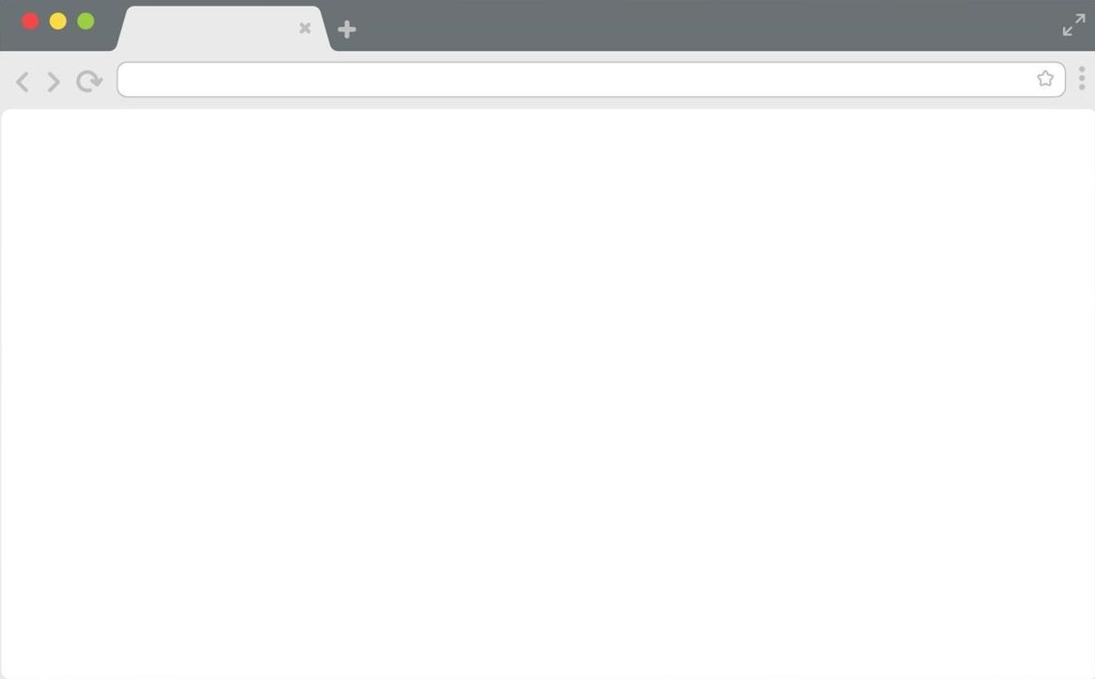
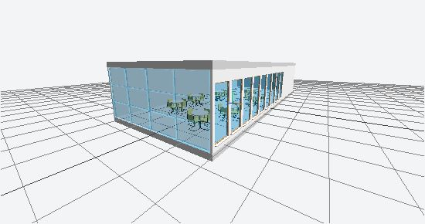
Decoupling of data and application
Different from old school BIM, where application (e.g. Revit) and data (e.g. .rvt) are very connected.

Slide 51
Decoupling of data and application
Decoupling enables others to add data to the graph and make this data available in the application
Window
Height: 1200 mm
Width: 600 mm

Slide 52
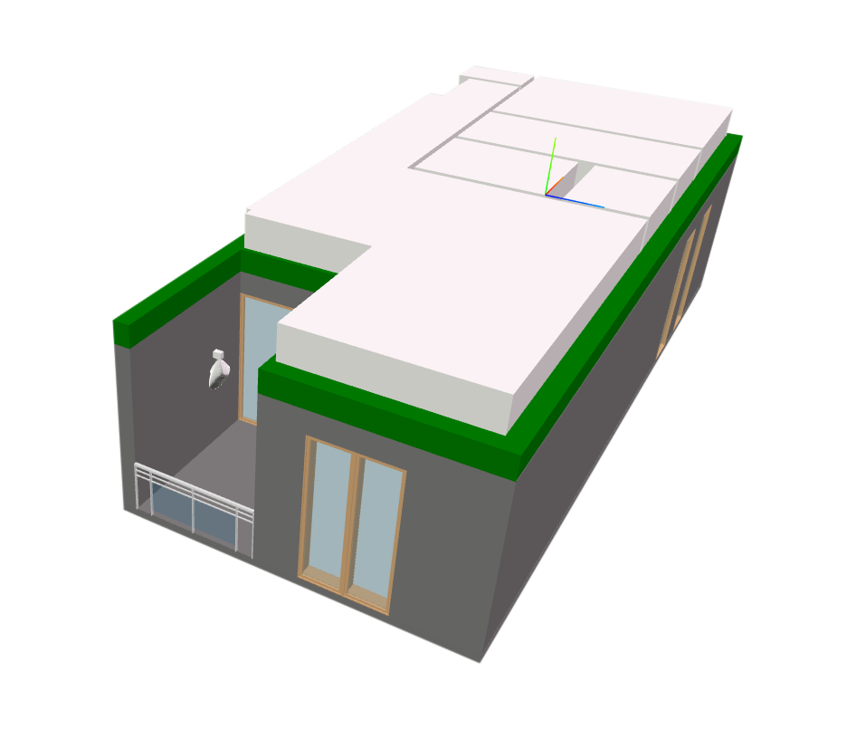

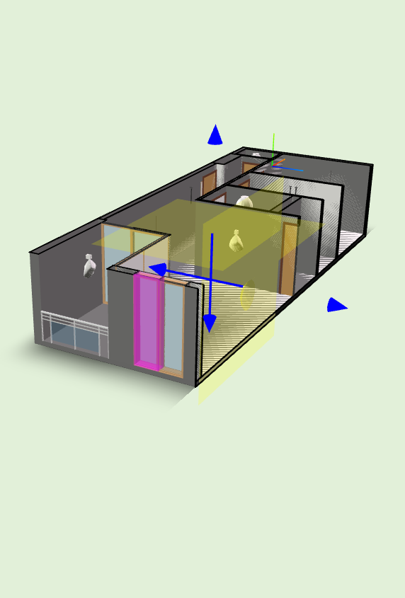
Decoupling of data and application
Decoupling enables software developers to build multiple applications on top of the same data.
MyHouse.ifc
Window
Height: 1200 mm
Width: 600 mm

Slide 53
Draw a graph of the space you’re sitting in

Slide 54
Draw a graph of the space you’re sitting in
Do all nodes and relationships have a label?
Are all relationships directed?
Is there a center node in the graph? If yes, what is it?
What types of information appear in your graph? Which types did you miss? How could you integrate those?

Slide 55
Methods to create a graph
Depending on the input data, different methods are required. Some methods are:
Manual (in any text editor)
Python-based (rdflib)
RML (RDF Mapping Language)
R2RML (RDB to RDF Mapping Language)
A handful of IFC to RDF converters exist, such as:
IFC2RDF (Python-based)
IFCtoLBD (Java-based, also has a UI)

Slide 56
RDF representation of the OpenFlat
OF:OpenFlat
a bot:Building , bop:FeatureOfInterest ;
bot:hasStorey OF:Level4 , OF:Level5 ;
bpt:hasGUID "413b2296-9449-4a05-8f3c-f009b9f294dc" ;
bpt:hasGlobalIdIfcRoot "11EoAMb4bA1Oyyy0cvyfJS" ;
bpt:hasName "OpenFlat" .
OF:Level5
a bot:Storey , bop:FeatureOfInterest ;
bot:containsElement OF:roof_d576136d-a0bf-4ebc-8644-d1110b3a9274 ;
bpt:hasGUID "413b2296-9449-4a05-8f3c-f00946082c36" ;
bpt:hasGlobalIdIfcRoot "11EoAMb4bA1Oyyy0b622ms" ;
bpt:hasName "Level 5" ;
bpt:hasElevation "12000." .
OF:roof_d576136d-a0bf-4ebc-8644-d1110b3a9274 ...

Slide 57
Possible, but difficult to understand as flat text
## This is the OpenFlat, an initiative by Alex Donkers.
## The OpenFlat can be used by researchers. More data is available on http://github.com/AlexDonkers/OpenFlat.
## While the exact location cannot be shared due to GDPR-regulations, it is located in The Netherlands. Therefore, researchers can use average Dutch climate data.
##
################################################################################################################################################################################################################################
################################################################################################################################################################################################################################
# PREFIXES
################################################################################################################################################################################################################################
################################################################################################################################################################################################################################
@prefix OF: <http://github.com/AlexDonkers/OpenFlat#> .
@prefix bop: <https://w3id.org/bop#> . # Building Performance Ontology
@prefix bpt: <https://w3id.org/bpt#> . # Building Property Taxonomy
@prefix bot: <https://w3id.org/bot#> . # Building Topology Ontology
@prefix beo: <http://pi.pauwel.be/voc/buildingelement#> . # Building Element Ontology
@prefix mep: <http://pi.pauwel.be/voc/distributionelement#> . # Distribution Elenemt Ontology
@prefix geo: <http://www.opengis.net/ont/geosparql#> . # GeoSPARQL
@prefix quantitykind: <http://qudt.org/vocab/quantitykind/> . # QUDT Quantity Kind ontology
@prefix owl: <http://www.w3.org/2002/07/owl#> . # Web Ontology Language
@prefix rdf: <http://www.w3.org/1999/02/22-rdf-syntax-ns#> . # Resource Description Framework
@prefix rdfs: <http://www.w3.org/2000/01/rdf-schema#> . # RDF Schema
################################################################################################################################################################################################################################
################################################################################################################################################################################################################################
# SITE
################################################################################################################################################################################################################################
################################################################################################################################################################################################################################
OF:OpenFlatSite
a geo:Feature , bot:Site , bop:FeatureOfInterest ;
bot:hasBuilding OF:building_413b2296-9449-4a05-8f3c-f009b9f294dc ;
bpt:hasGUID "413b2296-9449-4a05-8f3c-f009b9f294df" ;
bpt:hasGlobalIdIfcRoot "11EoAMb4bA1Oyyy0cvyfJV" ;
bpt:hasName "OpenFlatSite" ;
bpt:hasElevation "0" .
################################################################################################################################################################################################################################
################################################################################################################################################################################################################################
# BUILDING
################################################################################################################################################################################################################################
################################################################################################################################################################################################################################
OF:OpenFlat
a bot:Building , bop:FeatureOfInterest ;
bot:hasStorey OF:Level4 , OF:Level5 ;
bpt:hasGUID "413b2296-9449-4a05-8f3c-f009b9f294dc" ;
bpt:hasGlobalIdIfcRoot "11EoAMb4bA1Oyyy0cvyfJS" ;
bpt:hasName 123 .
################################################################################################################################################################################################################################
################################################################################################################################################################################################################################
# LEVELS
################################################################################################################################################################################################################################
################################################################################################################################################################################################################################
OF:Level4
a bot:Storey , bop:FeatureOfInterest ;
bot:containsElement OF:door_61646be3-03b9-4e10-b7f8-e8a8968e77bd , OF:wall_f27649ff-6b90-4736-ab52-98da77a1272d , OF:window_f27649ff-6b90-4736-ab52-98da77a101d5 , OF:door_f27649ff-6b90-4736-ab52-98da77a13911 , OF:flowterminal_5630b3e6-fb91-4ca6-905d-5e7761f49778 , OF:door_f27649ff-6b90-4736-ab52-98da77a13e77 , OF:wall_f27649ff-6b90-4736-ab52-98da77a13868 , OF:window_f27649ff-6b90-4736-ab52-98da77a1053d , OF:wall_f27649ff-6b90-4736-ab52-98da77a1355f , OF:wall_f27649ff-6b90-4736-ab52-98da77a13351 , OF:wall_f27649ff-6b90-4736-ab52-98da77a13dc5 , OF:window_f27649ff-6b90-4736-ab52-98da77a13fe7 , OF:window_f27649ff-6b90-4736-ab52-98da77a106ad , OF:slab_f27649ff-6b90-4736-ab52-98da77a13d7f , OF:window_f27649ff-6b90-4736-ab52-98da77a10348 , OF:wall_f27649ff-6b90-4736-ab52-98da77a13397 , OF:door_f27649ff-6b90-4736-ab52-98da77a102c3 , OF:wall_f27649ff-6b90-4736-ab52-98da77a12828 , OF:railing_f27649ff-6b90-4736-ab52-98da77a13990 , OF:wall_f27649ff-6b90-4736-ab52-98da77a12bfa , OF:wall_f27649ff-6b90-4736-ab52-98da77a1379c , OF:covering_61646be3-03b9-4e10-b7f8-e8a8968e744e , OF:window_f27649ff-6b90-4736-ab52-98da77a10020 , OF:wall_f27649ff-6b90-4736-ab52-98da77a13770 , OF:wall_f27649ff-6b90-4736-ab52-98da77a1320e , OF:window_f27649ff-6b90-4736-ab52-98da77a10075 , OF:wall_f27649ff-6b90-4736-ab52-98da77a13702 , OF:window_f27649ff-6b90-4736-ab52-98da77a10428 , OF:door_f27649ff-6b90-4736-ab52-98da77a13a9b , OF:wall_f27649ff-6b90-4736-ab52-98da77a13832 , OF:door_f27649ff-6b90-4736-ab52-98da77a13af5 , OF:wall_f27649ff-6b90-4736-ab52-98da77a12df4 , OF:door_61646be3-03b9-4e10-b7f8-e8a8968e7656 , OF:wall_f27649ff-6b90-4736-ab52-98da77a13295 ;
bot:hasSpace OF:Study , OF:Toilet , OF:Bedroom , OF:LivingRoom , OF:StorageRoom , OF:Bathroom ;
bpt:hasGUID "413b2296-9449-4a05-8f3c-f00946082da8" ;
bpt:hasGlobalIdIfcRoot "11EoAMb4bA1Oyyy0b622se" ;
bpt:hasName "Level 4" ;
bpt:hasElevation "9." .
OF:Level5
a bot:Storey , bop:FeatureOfInterest ;
bot:containsElement OF:roof_d576136d-a0bf-4ebc-8644-d1110b3a9274 ;
bpt:hasGUID "413b2296-9449-4a05-8f3c-f00946082c36" ;
bpt:hasGlobalIdIfcRoot "11EoAMb4bA1Oyyy0b622ms" ;
bpt:hasName "Level 5" ;
bpt:hasElevation "12000." .
################################################################################################################################################################################################################################
################################################################################################################################################################################################################################
# SPACES
################################################################################################################################################################################################################################
################################################################################################################################################################################################################################
OF:Study
a bot:Space , bop:FeatureOfInterest ;
bot:containsElement OF:flowterminal_5630b3e6-fb91-4ca6-905d-5e7761f4e493 , OF:flowterminal_5630b3e6-fb91-4ca6-905d-5e7761f4e4dd ;
bpt:hasGUID "f27649ff-6b90-4736-ab52-98da77a13e0c" ;
bpt:hasGlobalIdIfcRoot "3oTad$Qv17DgjIcDfteJuC" ;
bpt:hasName "Study" ;
bot:adjacentElement OF:wall_f27649ff-6b90-4736-ab52-98da77a1320e ,
OF:wall_f27649ff-6b90-4736-ab52-98da77a1272d ,
OF:wall_f27649ff-6b90-4736-ab52-98da77a13295 ,
OF:wall_f27649ff-6b90-4736-ab52-98da77a13351 .
OF:Toilet
a bot:Space , bop:FeatureOfInterest ;
bot:containsElement OF:flowterminal_5630b3e6-fb91-4ca6-905d-5e7761f4c506 ;
bpt:hasGUID "f27649ff-6b90-4736-ab52-98da77a13e28" ;
bpt:hasGlobalIdIfcRoot "3oTad$Qv17DgjIcDfteJue" ;
bpt:hasName "Toilet" ;
bot:adjacentElement OF:wall_f27649ff-6b90-4736-ab52-98da77a13770 ,
OF:wall_f27649ff-6b90-4736-ab52-98da77a13351 ,
OF:wall_f27649ff-6b90-4736-ab52-98da77a1379c ,
OF:wall_f27649ff-6b90-4736-ab52-98da77a13702 .
OF:Bedroom
a bot:Space , bop:FeatureOfInterest ;
bot:containsElement OF:flowterminal_5630b3e6-fb91-4ca6-905d-5e7761f4e568 , OF:flowterminal_5630b3e6-fb91-4ca6-905d-5e7761f4f233 ;
bpt:hasGUID "f27649ff-6b90-4736-ab52-98da77a13e11" ;
bpt:hasGlobalIdIfcRoot "3oTad$Qv17DgjIcDfteJuH" ;
bpt:hasName "Bedroom" ;
bot:adjacentElement OF:wall_f27649ff-6b90-4736-ab52-98da77a1272d ,
OF:wall_f27649ff-6b90-4736-ab52-98da77a13295 ,
OF:wall_f27649ff-6b90-4736-ab52-98da77a13351 ,
OF:wall_f27649ff-6b90-4736-ab52-98da77a13702 .
OF:LivingRoom
a bot:Space , bop:FeatureOfInterest ;
bot:containsElement OF:flowterminal_5630b3e6-fb91-4ca6-905d-5e7761f4bca1 , OF:flowterminal_5630b3e6-fb91-4ca6-905d-5e7761f48317 , OF:flowterminal_5630b3e6-fb91-4ca6-905d-5e7761f4e263 , OF:flowterminal_5630b3e6-fb91-4ca6-905d-5e7761f4f150 , OF:flowterminal_5630b3e6-fb91-4ca6-905d-5e7761f4f320 ;
bpt:hasGUID "f27649ff-6b90-4736-ab52-98da77a13e17" ;
bpt:hasGlobalIdIfcRoot "3oTad$Qv17DgjIcDfteJuN" ;
bpt:hasName "LivingRoom" ;
bot:hasElement OF:KitchenTable ;
bot:adjacentElement OF:wall_f27649ff-6b90-4736-ab52-98da77a12df4 ,
OF:wall_f27649ff-6b90-4736-ab52-98da77a12828 ,
OF:wall_f27649ff-6b90-4736-ab52-98da77a13770 ,
OF:wall_f27649ff-6b90-4736-ab52-98da77a12bfa ,
OF:wall_f27649ff-6b90-4736-ab52-98da77a13832 ,
OF:wall_f27649ff-6b90-4736-ab52-98da77a13397 ,
OF:wall_f27649ff-6b90-4736-ab52-98da77a1272d ,
OF:wall_f27649ff-6b90-4736-ab52-98da77a13868 ,
OF:wall_f27649ff-6b90-4736-ab52-98da77a1355f ,
OF:wall_f27649ff-6b90-4736-ab52-98da77a13351 .
OF:StorageRoom
a bot:Space , bop:FeatureOfInterest ;
bpt:hasGUID "f27649ff-6b90-4736-ab52-98da77a13e12" ;
bpt:hasGlobalIdIfcRoot "3oTad$Qv17DgjIcDfteJuI" ;
bpt:hasName "StorageRoom" ;
bot:adjacentElement OF:wall_f27649ff-6b90-4736-ab52-98da77a13dc5 ,
OF:wall_f27649ff-6b90-4736-ab52-98da77a1320e ,
OF:wall_f27649ff-6b90-4736-ab52-98da77a13397 ,
OF:wall_f27649ff-6b90-4736-ab52-98da77a1272d .
OF:Bathroom
a bot:Space , bop:FeatureOfInterest ;
bot:containsElement OF:flowterminal_5630b3e6-fb91-4ca6-905d-5e7761f4f2fc , OF:flowterminal_5630b3e6-fb91-4ca6-905d-5e7761f4c5fb ;
bpt:hasGUID "f27649ff-6b90-4736-ab52-98da77a13e0b" ;
bpt:hasGlobalIdIfcRoot "3oTad$Qv17DgjIcDfteJuB" ;
bpt:hasName "Bathroom" ;
bot:adjacentElement OF:wall_f27649ff-6b90-4736-ab52-98da77a13dc5 ,
OF:wall_f27649ff-6b90-4736-ab52-98da77a1320e ,
OF:wall_f27649ff-6b90-4736-ab52-98da77a13397 ,
OF:wall_f27649ff-6b90-4736-ab52-98da77a13351 .
################################################################################################################################################################################################################################
################################################################################################################################################################################################################################
# FURNITURE
################################################################################################################################################################################################################################
################################################################################################################################################################################################################################
### Furniture has not been modeled in Revit and therefore has no GUID or other references to geometrical elements.
OF:KitchenTable
a bot:Element , bop:FeatureOfInterest , bop:Platform ;
bop:hosts OF:SeeedGroveAirQualitySensorV1_3 , OF:SeeedTemperatureAndHumiditySensorDHT11 .
################################################################################################################################################################################################################################
################################################################################################################################################################################################################################
# WALLS
################################################################################################################################################################################################################################
################################################################################################################################################################################################################################
OF:wall_f27649ff-6b90-4736-ab52-98da77a12828
a beo:Wall , bot:Element , bop:FeatureOfInterest ;
bot:hasSubElement OF:window_f27649ff-6b90-4736-ab52-98da77a10348 , OF:window_f27649ff-6b90-4736-ab52-98da77a10428 ;
bpt:hasGUID "f27649ff-6b90-4736-ab52-98da77a12828" ;
bpt:hasGlobalIdIfcRoot "3oTad$Qv17DgjIcDfteIWe" ;
bpt:hasBatID "346281" ;
bpt:isExterior "True" ;
bpt:hasLength "3480" ;
bpt:hasThickness "300" ;
bpt:hasHeight "2595" ;
bpt:hasThermalResistance "4.5" ;
bpt:hasSolarAzimuth "90" .
OF:wall_f27649ff-6b90-4736-ab52-98da77a12df4
a beo:Wall , bot:Element , bop:FeatureOfInterest ;
bot:hasSubElement OF:door_f27649ff-6b90-4736-ab52-98da77a13e77 , OF:window_f27649ff-6b90-4736-ab52-98da77a13fe7 ;
bpt:hasGUID "f27649ff-6b90-4736-ab52-98da77a12df4" ;
bpt:hasGlobalIdIfcRoot "3oTad$Qv17DgjIcDfteItq" ;
bpt:hasBatID "347509" ;
bpt:isExterior "False" ;
bpt:hasLength "7580" ;
bpt:hasThickness "200" ;
bpt:hasHeight "2595" ;
bpt:hasThermalResistance "0.2" .
OF:wall_f27649ff-6b90-4736-ab52-98da77a13dc5
a beo:Wall , bot:Element , bop:FeatureOfInterest ;
bpt:hasGUID "f27649ff-6b90-4736-ab52-98da77a13dc5" ;
bpt:hasGlobalIdIfcRoot "3oTad$Qv17DgjIcDfteJt5" ;
bpt:hasBatID "351556" ;
bpt:isExterior "False" ;
bpt:hasLength "2000" ;
bpt:hasThickness "300" ;
bpt:hasHeight "2595" ;
bpt:hasThermalResistance "0.2" .
OF:wall_f27649ff-6b90-4736-ab52-98da77a13770
a beo:Wall , bot:Element , bop:FeatureOfInterest ;
bot:hasSubElement OF:door_61646be3-03b9-4e10-b7f8-e8a8968e7656 ;
bpt:hasGUID "f27649ff-6b90-4736-ab52-98da77a13770" ;
bpt:hasGlobalIdIfcRoot "3oTad$Qv17DgjIcDfteJTm" ;
bpt:hasBatID "350193" ;
bpt:isExterior "False" ;
bpt:hasLength "1600" ;
bpt:hasThickness "100" ;
bpt:hasHeight "2595" ;
bpt:hasThermalResistance "0.2" .
OF:wall_f27649ff-6b90-4736-ab52-98da77a12bfa
a beo:Wall , bot:Element , bop:FeatureOfInterest ;
bpt:hasGUID "f27649ff-6b90-4736-ab52-98da77a12bfa" ;
bpt:hasGlobalIdIfcRoot "3oTad$Qv17DgjIcDfteIlw" ;
bpt:hasBatID "347003" ;
bpt:isExterior "True" ;
bpt:hasLength "3400" ;
bpt:hasThickness "300" ;
bpt:hasHeight "2595" ;
bpt:hasThermalResistance "4.5" ;
bpt:hasSolarAzimuth "0" .
OF:wall_f27649ff-6b90-4736-ab52-98da77a1320e
a beo:Wall , bot:Element , bop:FeatureOfInterest ;
bpt:hasGUID "f27649ff-6b90-4736-ab52-98da77a1320e" ;
bpt:hasGlobalIdIfcRoot "3oTad$Qv17DgjIcDfteJ8E" ;
bpt:hasBatID "348815" ;
bpt:isExterior "False" ;
bpt:hasLength "4330" ;
bpt:hasThickness "100" ;
bpt:hasHeight "2595" ;
bpt:hasThermalResistance "0.2" .
OF:wall_f27649ff-6b90-4736-ab52-98da77a13832
a beo:Wall , bot:Element , bop:FeatureOfInterest ;
bot:hasSubElement OF:window_f27649ff-6b90-4736-ab52-98da77a101d5 , OF:door_f27649ff-6b90-4736-ab52-98da77a102c3 ;
bpt:hasGUID "f27649ff-6b90-4736-ab52-98da77a13832" ;
bpt:hasGlobalIdIfcRoot "3oTad$Qv17DgjIcDfteJWo" ;
bpt:hasBatID "350387" ;
bpt:isExterior "True" ;
bpt:hasLength "2400" ;
bpt:hasThickness "100" ;
bpt:hasHeight "2595" ;
bpt:hasThermalResistance "4.5" ;
bpt:hasSolarAzimuth "90" .
OF:wall_f27649ff-6b90-4736-ab52-98da77a13397
a beo:Wall , bot:Element , bop:FeatureOfInterest ;
bot:hasSubElement OF:door_61646be3-03b9-4e10-b7f8-e8a8968e77bd ;
bpt:hasGUID "f27649ff-6b90-4736-ab52-98da77a13397" ;
bpt:hasGlobalIdIfcRoot "3oTad$Qv17DgjIcDfteJEN" ;
bpt:hasBatID "348950" ;
bpt:isExterior "False" ;
bpt:hasLength "4330" ;
bpt:hasThickness "100" ;
bpt:hasHeight "2595" ;
bpt:hasThermalResistance "0.2" .
OF:wall_f27649ff-6b90-4736-ab52-98da77a1272d
a beo:Wall , bot:Element , bop:FeatureOfInterest ;
bot:hasSubElement OF:window_f27649ff-6b90-4736-ab52-98da77a106ad , OF:window_f27649ff-6b90-4736-ab52-98da77a1053d ;
bpt:hasGUID "f27649ff-6b90-4736-ab52-98da77a1272d" ;
bpt:hasGlobalIdIfcRoot "3oTad$Qv17DgjIcDfteISj" ;
bpt:hasBatID "346028" ;
bpt:isExterior "True" ;
bpt:hasLength "13450" ;
bpt:hasThickness "300" ;
bpt:hasHeight "2595" ;
bpt:hasThermalResistance "4.5" ;
bpt:hasSolarAzimuth "0" .
OF:wall_f27649ff-6b90-4736-ab52-98da77a13295
a beo:Wall , bot:Element , bop:FeatureOfInterest ;
bpt:hasGUID "f27649ff-6b90-4736-ab52-98da77a13295" ;
bpt:hasGlobalIdIfcRoot "3oTad$Qv17DgjIcDfteJAL" ;
bpt:hasBatID "348692" ;
bpt:isExterior "False" ;
bpt:hasLength "4330" ;
bpt:hasThickness "100" ;
bpt:hasHeight "2595" ;
bpt:hasThermalResistance "0.2" .
OF:wall_f27649ff-6b90-4736-ab52-98da77a13868
a beo:Wall , bot:Element , bop:FeatureOfInterest ;
bot:hasSubElement OF:window_f27649ff-6b90-4736-ab52-98da77a10075 , OF:window_f27649ff-6b90-4736-ab52-98da77a10020 ;
bpt:hasGUID "f27649ff-6b90-4736-ab52-98da77a13868" ;
bpt:hasGlobalIdIfcRoot "3oTad$Qv17DgjIcDfteJXe" ;
bpt:hasBatID "350441" ;
bpt:isExterior "True" ;
bpt:hasLength "3000" ;
bpt:hasThickness "100" ;
bpt:hasHeight "2595" ;
bpt:hasThermalResistance "4.5" ;
bpt:hasSolarAzimuth "180" .
OF:wall_f27649ff-6b90-4736-ab52-98da77a1355f
a beo:Wall , bot:Element , bop:FeatureOfInterest ;
bpt:hasGUID "f27649ff-6b90-4736-ab52-98da77a1355f" ;
bpt:hasGlobalIdIfcRoot "3oTad$Qv17DgjIcDfteJLV" ;
bpt:hasBatID "349662" ;
bpt:isExterior "False" ;
bpt:hasLength "1570" ;
bpt:hasThickness "500" ;
bpt:hasHeight "2595" ;
bpt:hasThermalResistance "0.2" .
OF:wall_f27649ff-6b90-4736-ab52-98da77a13351
a beo:Wall , bot:Element , bop:FeatureOfInterest ;
bot:hasSubElement OF:door_f27649ff-6b90-4736-ab52-98da77a13af5 , OF:door_f27649ff-6b90-4736-ab52-98da77a13911 , OF:door_f27649ff-6b90-4736-ab52-98da77a13a9b ;
bpt:hasGUID "f27649ff-6b90-4736-ab52-98da77a13351" ;
bpt:hasGlobalIdIfcRoot "3oTad$Qv17DgjIcDfteJDH" ;
bpt:hasBatID "349136" ;
bpt:isExterior "False" ;
bpt:hasLength "6970" ;
bpt:hasThickness "100" ;
bpt:hasHeight "2595" ;
bpt:hasThermalResistance "0.2" .
OF:wall_f27649ff-6b90-4736-ab52-98da77a1379c
a beo:Wall , bot:Element , bop:FeatureOfInterest ;
bpt:hasGUID "f27649ff-6b90-4736-ab52-98da77a1379c" ;
bpt:hasGlobalIdIfcRoot "3oTad$Qv17DgjIcDfteJUS" ;
bpt:hasBatID "349981" ;
bpt:isExterior "False" ;
bpt:hasLength "1050" ;
bpt:hasThickness "200" ;
bpt:hasHeight "2595" ;
bpt:hasThermalResistance "0.2" .
OF:wall_f27649ff-6b90-4736-ab52-98da77a13702
a beo:Wall , bot:Element , bop:FeatureOfInterest ;
bpt:hasGUID "f27649ff-6b90-4736-ab52-98da77a13702" ;
bpt:hasGlobalIdIfcRoot "3oTad$Qv17DgjIcDfteJS2" ;
bpt:hasBatID "350083" ;
bpt:isExterior "False" ;
bpt:hasLength "5930" ;
bpt:hasThickness "200" ;
bpt:hasHeight "2595" ;
bpt:hasThermalResistance "4.5" .
################################################################################################################################################################################################################################
################################################################################################################################################################################################################################
# Doors
################################################################################################################################################################################################################################
################################################################################################################################################################################################################################
OF:door_f27649ff-6b90-4736-ab52-98da77a13af5
a beo:Door , bot:Element , bop:FeatureOfInterest;
bpt:hasGUID "f27649ff-6b90-4736-ab52-98da77a13af5" ;
bpt:hasGlobalIdIfcRoot "3oTad$Qv17DgjIcDfteJhr" ;
bpt:hasBatID "350836" ;
bpt:hasName "BathroomDoor" ;
bpt:isExterior "False" ;
bpt:hasLength "950" ;
bpt:hasThickness "51" ;
bpt:hasHeight "2300" ;
bpt:hasThermalResistance "0.1" .
OF:door_f27649ff-6b90-4736-ab52-98da77a13911
a beo:Door , bot:Element , bop:FeatureOfInterest;
bpt:hasGUID "f27649ff-6b90-4736-ab52-98da77a13911" ;
bpt:hasGlobalIdIfcRoot "3oTad$Qv17DgjIcDfteJaH" ;
bpt:hasBatID "350608" ;
bpt:hasName "BedroomDoor" ;
bpt:isExterior "False" ;
bpt:hasLength "950" ;
bpt:hasThickness "51" ;
bpt:hasHeight "2300" ;
bpt:hasThermalResistance "0.1" .
OF:door_f27649ff-6b90-4736-ab52-98da77a102c3
a beo:Door , bot:Element , bop:FeatureOfInterest;
bpt:hasGUID "f27649ff-6b90-4736-ab52-98da77a102c3" ;
bpt:hasGlobalIdIfcRoot "3oTad$Qv17DgjIcDfteGB3" ;
bpt:hasBatID "352834" ;
bpt:hasName "BalconyDoor" ;
bpt:isExterior "True" ;
bpt:hasLength "1100" ;
bpt:hasThickness "51" ;
bpt:hasHeight "2600" ;
bpt:hasThermalResistance "0.5" .
OF:door_f27649ff-6b90-4736-ab52-98da77a13a9b
a beo:Door , bot:Element , bop:FeatureOfInterest;
bpt:hasGUID "f27649ff-6b90-4736-ab52-98da77a13a9b" ;
bpt:hasGlobalIdIfcRoot "3oTad$Qv17DgjIcDfteJgR" ;
bpt:hasBatID "350746" ;
bpt:hasName "StudyDoor" ;
bpt:isExterior "False" ;
bpt:hasLength "950" ;
bpt:hasThickness "51" ;
bpt:hasHeight "2300" ;
bpt:hasThermalResistance "0.1" .
OF:door_61646be3-03b9-4e10-b7f8-e8a8968e77bd
a beo:Door , bot:Element , bop:FeatureOfInterest;
bpt:hasGUID "61646be3-03b9-4e10-b7f8-e8a8968e77bd" ;
bpt:hasGlobalIdIfcRoot "1XP6lZ0xbE4BVuwAYMZdUz" ;
bpt:hasBatID "364833" ;
bpt:hasName "StorageRoomDoor" ;
bpt:isExterior "False" ;
bpt:hasLength "950" ;
bpt:hasThickness "51" ;
bpt:hasHeight "2300" ;
bpt:hasThermalResistance "0.1" .
OF:door_f27649ff-6b90-4736-ab52-98da77a13e77
a beo:Door , bot:Element , bop:FeatureOfInterest;
bpt:hasGUID "f27649ff-6b90-4736-ab52-98da77a13e77" ;
bpt:hasGlobalIdIfcRoot "3oTad$Qv17DgjIcDfteJvt" ;
bpt:hasBatID "351990" ;
bpt:hasName "DoorToSharedStaircase" ;
bpt:isExterior "False" ;
bpt:hasLength "950" ;
bpt:hasThickness "51" ;
bpt:hasHeight "2300" ;
bpt:hasThermalResistance "0.1" .
OF:door_61646be3-03b9-4e10-b7f8-e8a8968e7656
a beo:Door , bot:Element , bop:FeatureOfInterest;
bpt:hasGUID "61646be3-03b9-4e10-b7f8-e8a8968e7656" ;
bpt:hasGlobalIdIfcRoot "1XP6lZ0xbE4BVuwAYMZdPM" ;
bpt:hasBatID "364746" ;
bpt:hasName "ToiletDoor" ;
bpt:isExterior "False" ;
bpt:hasLength "950" ;
bpt:hasThickness "51" ;
bpt:hasHeight "2300" ;
bpt:hasThermalResistance "0.1" .
################################################################################################################################################################################################################################
################################################################################################################################################################################################################################
# WINDOWS
################################################################################################################################################################################################################################
################################################################################################################################################################################################################################
OF:window_f27649ff-6b90-4736-ab52-98da77a10020
a beo:Window , bot:Element , bop:FeatureOfInterest;
bpt:hasGUID "f27649ff-6b90-4736-ab52-98da77a10020" ;
bpt:hasGlobalIdIfcRoot "3oTad$Qv17DgjIcDfteG0W" ;
bpt:hasBatID "352417" ;
bpt:hasName "BalconyWindow" ;
bpt:isExterior "True" ;
bpt:hasLength "1400" ;
bpt:hasThickness "51" ;
bpt:hasHeight "2600" ;
bpt:hasThermalResistance "0.5" .
OF:window_f27649ff-6b90-4736-ab52-98da77a1053d
a beo:Window , bot:Element , bop:FeatureOfInterest;
bpt:hasGUID "f27649ff-6b90-4736-ab52-98da77a1053d" ;
bpt:hasGlobalIdIfcRoot "3oTad$Qv17DgjIcDfteGKz" ;
bpt:hasBatID "353724" ;
bpt:hasName "StudyWindow" ;
bpt:isExterior "True" ;
bpt:hasLength "750" ;
bpt:hasThickness "51" ;
bpt:hasHeight "2600" ;
bpt:hasThermalResistance "0.5" .
OF:window_f27649ff-6b90-4736-ab52-98da77a106ad
a beo:Window , bot:Element , bop:FeatureOfInterest;
bpt:hasGUID "f27649ff-6b90-4736-ab52-98da77a106ad" ;
bpt:hasGlobalIdIfcRoot "3oTad$Qv17DgjIcDfteGQj" ;
bpt:hasBatID "353836" ;
bpt:hasName "BedroomWindow" ;
bpt:isExterior "True" ;
bpt:hasLength "750" ;
bpt:hasThickness "51" ;
bpt:hasHeight "2600" ;
bpt:hasThermalResistance "0.5" .
OF:window_f27649ff-6b90-4736-ab52-98da77a10075
a beo:Window , bot:Element , bop:FeatureOfInterest;
bpt:hasGUID "f27649ff-6b90-4736-ab52-98da77a10075" ;
bpt:hasGlobalIdIfcRoot "3oTad$Qv17DgjIcDfteG1r" ;
bpt:hasBatID "352500" ;
bpt:hasName "BalconyWindow" ;
bpt:isExterior "True" ;
bpt:hasLength "1400" ;
bpt:hasThickness "51" ;
bpt:hasHeight "2600" ;
bpt:hasThermalResistance "0.5" .
OF:window_f27649ff-6b90-4736-ab52-98da77a10348
a beo:Window , bot:Element , bop:FeatureOfInterest;
bpt:hasGUID "f27649ff-6b90-4736-ab52-98da77a10348" ;
bpt:hasGlobalIdIfcRoot "3oTad$Qv17DgjIcDfteGD8" ;
bpt:hasBatID "353225" ;
bpt:hasName "LivingRoomWindow" ;
bpt:isExterior "True" ;
bpt:hasLength "750" ;
bpt:hasThickness "51" ;
bpt:hasHeight "2600" ;
bpt:hasThermalResistance "0.5" .
OF:window_f27649ff-6b90-4736-ab52-98da77a101d5
a beo:Window , bot:Element , bop:FeatureOfInterest;
bpt:hasGUID "f27649ff-6b90-4736-ab52-98da77a101d5" ;
bpt:hasGlobalIdIfcRoot "3oTad$Qv17DgjIcDfteG7L" ;
bpt:hasBatID "352596" ;
bpt:hasName "BalconyWindow" ;
bpt:isExterior "True" ;
bpt:hasLength "1100" ;
bpt:hasThickness "51" ;
bpt:hasHeight "2600" ;
bpt:hasThermalResistance "0.5" .
OF:window_f27649ff-6b90-4736-ab52-98da77a10428
a beo:Window , bot:Element , bop:FeatureOfInterest;
bpt:hasGUID "f27649ff-6b90-4736-ab52-98da77a10428" ;
bpt:hasGlobalIdIfcRoot "3oTad$Qv17DgjIcDfteGGe" ;
bpt:hasBatID "353449" ;
bpt:hasName "LivingRoomWindow" ;
bpt:isExterior "True" ;
bpt:hasLength "750" ;
bpt:hasThickness "51" ;
bpt:hasHeight "2600" ;
bpt:hasThermalResistance "0.5" .
OF:window_f27649ff-6b90-4736-ab52-98da77a13fe7
a beo:Window , bot:Element , bop:FeatureOfInterest;
bpt:hasGUID "f27649ff-6b90-4736-ab52-98da77a13fe7" ;
bpt:hasGlobalIdIfcRoot "3oTad$Qv17DgjIcDfteJ$d" ;
bpt:hasBatID "352102" ;
bpt:hasName "HallWindow" ;
bpt:isExterior "False" ;
bpt:hasLength "200" ;
bpt:hasThickness "51" ;
bpt:hasHeight "2210" ;
bpt:hasThermalResistance "0.5" .
################################################################################################################################################################################################################################
################################################################################################################################################################################################################################
# FLOOR SLABS
################################################################################################################################################################################################################################
################################################################################################################################################################################################################################
OF:slab_d576136d-a0bf-4ebc-8644-d1130b3a9274
a beo:Slab , beo:Slab-ROOF, bot:Element , bop:FeatureOfInterest;
bpt:hasGUID "d576136d-a0bf-4ebc-8644-d1130b3a9274" ;
bpt:hasGlobalIdIfcRoot "3LTXDjeBzEl8P4qHCBEf9q" ;
bpt:hasBatID "360271" ;
bpt:hasName "RoofSlab"
;
bpt:isExterior "True" ;
bpt:hasThickness "400" ;
bpt:hasThermalResistance "6" .
OF:slab_f27649ff-6b90-4736-ab52-98da77a13d7f
a beo:Slab , beo:Slab-FLOOR, bot:Element , bop:FeatureOfInterest;
bpt:hasGUID "f27649ff-6b90-4736-ab52-98da77a13d7f" ;
bpt:hasGlobalIdIfcRoot "3oTad$Qv17DgjIcDfteJr$" ;
bpt:hasBatID "351742" ;
bpt:hasName "FloorSlab" ;
bpt:isExterior "False" ;
bpt:hasThickness "400" ;
bpt:hasThermalResistance "4.5" .
################################################################################################################################################################################################################################
################################################################################################################################################################################################################################
# INTERFACES
################################################################################################################################################################################################################################
################################################################################################################################################################################################################################
OF:Interface1
a bot:Interface , bop:FeatureOfInterest ;
bot:interfaceOf OF:LivingRoom , OF:wall_f27649ff-6b90-4736-ab52-98da77a1272d ;
bpt:hasArea "16.30" .
OF:Interface2
a bot:Interface , bop:FeatureOfInterest ;
bot:interfaceOf OF:LivingRoom , OF:wall_f27649ff-6b90-4736-ab52-98da77a12828 ;
bpt:hasArea "4.61" .
OF:Interface3
a bot:Interface , bop:FeatureOfInterest ;
bot:interfaceOf OF:LivingRoom , OF:window_f27649ff-6b90-4736-ab52-98da77a10428 ;
bpt:hasArea "1.95" .
OF:Interface4
a bot:Interface , bop:FeatureOfInterest ;
bot:interfaceOf OF:LivingRoom , OF:window_f27649ff-6b90-4736-ab52-98da77a10348 ;
bpt:hasArea "1.95" .
OF:Interface5
a bot:Interface , bop:FeatureOfInterest ;
bot:interfaceOf OF:LivingRoom , OF:wall_f27649ff-6b90-4736-ab52-98da77a13868 ;
bpt:hasArea "0.26" .
OF:Interface6
a bot:Interface , bop:FeatureOfInterest ;
bot:interfaceOf OF:LivingRoom , OF:window_f27649ff-6b90-4736-ab52-98da77a10020 ;
bpt:hasArea "3.64" .
OF:Interface7
a bot:Interface , bop:FeatureOfInterest ;
bot:interfaceOf OF:LivingRoom , OF:window_f27649ff-6b90-4736-ab52-98da77a10075 ;
bpt:hasArea "3.64" .
OF:Interface8
a bot:Interface , bop:FeatureOfInterest ;
bot:interfaceOf OF:LivingRoom , OF:wall_f27649ff-6b90-4736-ab52-98da77a13832 ;
bpt:hasArea "0.26" .
OF:Interface9
a bot:Interface , bop:FeatureOfInterest ;
bot:interfaceOf OF:LivingRoom , OF:door_f27649ff-6b90-4736-ab52-98da77a102c3 ;
bpt:hasArea "2.86" .
OF:Interface10
a bot:Interface , bop:FeatureOfInterest ;
bot:interfaceOf OF:LivingRoom , OF:window_f27649ff-6b90-4736-ab52-98da77a101d5 ;
bpt:hasArea "2.86" .
OF:Interface11
a bot:Interface , bop:FeatureOfInterest ;
bot:interfaceOf OF:LivingRoom , OF:wall_f27649ff-6b90-4736-ab52-98da77a12bfa ;
bpt:hasArea "0.78" .
OF:Interface12
a bot:Interface , bop:FeatureOfInterest ;
bot:interfaceOf OF:LivingRoom , OF:wall_f27649ff-6b90-4736-ab52-98da77a12df4 ;
bpt:hasArea "17.04" .
OF:Interface13
a bot:Interface , bop:FeatureOfInterest ;
bot:interfaceOf OF:LivingRoom , OF:door_f27649ff-6b90-4736-ab52-98da77a13e77 ;
bpt:hasArea "2.19" .
OF:Interface14
a bot:Interface , bop:FeatureOfInterest ;
bot:interfaceOf OF:LivingRoom , OF:window_f27649ff-6b90-4736-ab52-98da77a13fe7 ;
bpt:hasArea "0.44" .
OF:Interface15
a bot:Interface , bop:FeatureOfInterest ;
bot:interfaceOf OF:LivingRoom , OF:wall_f27649ff-6b90-4736-ab52-98da77a1355f ;
bpt:hasArea "4.72" .
OF:Interface16
a bot:Interface , bop:FeatureOfInterest ;
bot:interfaceOf OF:LivingRoom , OF:wall_f27649ff-6b90-4736-ab52-98da77a13770 ;
bpt:hasArea "0.52" .
OF:Interface17
a bot:Interface , bop:FeatureOfInterest ;
bot:interfaceOf OF:LivingRoom , OF:door_61646be3-03b9-4e10-b7f8-e8a8968e7656 ;
bpt:hasArea "2.19" .
OF:Interface18
a bot:Interface , bop:FeatureOfInterest ;
bot:interfaceOf OF:LivingRoom , OF:wall_f27649ff-6b90-4736-ab52-98da77a13351 ;
bpt:hasArea "8.81" .
OF:Interface19
a bot:Interface , bop:FeatureOfInterest ;
bot:interfaceOf OF:LivingRoom , OF:door_f27649ff-6b90-4736-ab52-98da77a13911 ;
bpt:hasArea "2.19" .
OF:Interface20
a bot:Interface , bop:FeatureOfInterest ;
bot:interfaceOf OF:LivingRoom , OF:door_f27649ff-6b90-4736-ab52-98da77a13a9b ;
bpt:hasArea "2.19" .
OF:Interface21
a bot:Interface , bop:FeatureOfInterest ;
bot:interfaceOf OF:LivingRoom , OF:door_f27649ff-6b90-4736-ab52-98da77a13af5 ;
bpt:hasArea "2.19" .
OF:Interface22
a bot:Interface , bop:FeatureOfInterest ;
bot:interfaceOf OF:LivingRoom , OF:wall_f27649ff-6b90-4736-ab52-98da77a13397 ;
bpt:hasArea "9.05" .
OF:Interface23
a bot:Interface , bop:FeatureOfInterest ;
bot:interfaceOf OF:LivingRoom , OF:door_61646be3-03b9-4e10-b7f8-e8a8968e77bd ;
bpt:hasArea "2.19" .
################################################################################################################################################################################################################################
################################################################################################################################################################################################################################
# ACTUATORS
################################################################################################################################################################################################################################
################################################################################################################################################################################################################################
OF:flowterminal_5630b3e6-fb91-4ca6-905d-5e7761f4f2fc
a mep:FlowTerminal , mep:LED , bot:Element , bop:FeatureOfInterest ;
bpt:hasGUID "5630b3e6-fb91-4ca6-905d-5e7761f4f2fc" ;
bpt:hasGlobalIdIfcRoot "1MCBFc_v5Cff1TNdTXzFBy" ;
bpt:hasBatID "414455" ;
bpt:hasName "BathroomMirrorLED" .
OF:flowterminal_5630b3e6-fb91-4ca6-905d-5e7761f4c5fb
a mep:FlowTerminal , mep:Halogen , bot:Element , bop:FeatureOfInterest ;
bpt:hasGUID "5630b3e6-fb91-4ca6-905d-5e7761f4c5fb" ;
bpt:hasGlobalIdIfcRoot "1MCBFc_v5Cff1TNdTXzCNx" ;
bpt:hasBatID "419312" ;
bpt:hasName "BathroomHalogenLamp" .
OF:flowterminal_5630b3e6-fb91-4ca6-905d-5e7761f4e4dd
a mep:FlowTerminal , mep:Halogen , bot:Element , bop:FeatureOfInterest ;
bpt:hasGUID "5630b3e6-fb91-4ca6-905d-5e7761f4e4dd" ;
bpt:hasGlobalIdIfcRoot "1MCBFc_v5Cff1TNdTXzEJT" ;
bpt:hasBatID "410838" ;
bpt:hasName "StudyHalogenLamp" .
OF:flowterminal_5630b3e6-fb91-4ca6-905d-5e7761f4c506
a mep:FlowTerminal , mep:Halogen , bot:Element , bop:FeatureOfInterest ;
bpt:hasGUID "5630b3e6-fb91-4ca6-905d-5e7761f4c506" ;
bpt:hasGlobalIdIfcRoot "1MCBFc_v5Cff1TNdTXzCK6" ;
bpt:hasBatID "419085" ;
bpt:hasName "ToiletHalogenLamp" .
OF:flowterminal_5630b3e6-fb91-4ca6-905d-5e7761f48317
a mep:FlowTerminal , mep:LED , bot:Element , bop:FeatureOfInterest ;
bpt:hasGUID "5630b3e6-fb91-4ca6-905d-5e7761f48317" ;
bpt:hasGlobalIdIfcRoot "1MCBFc_v5Cff1TNdTXz8CN" ;
bpt:hasBatID "402204" ;
bpt:hasName "LivingRoomStandingLED" .
OF:flowterminal_5630b3e6-fb91-4ca6-905d-5e7761f4f233
a mep:FlowTerminal , mep:LED , bot:Element , bop:FeatureOfInterest ;
bpt:hasGUID "5630b3e6-fb91-4ca6-905d-5e7761f4f233" ;
bpt:hasGlobalIdIfcRoot "1MCBFc_v5Cff1TNdTXzF8p" ;
bpt:hasBatID "414264" ;
bpt:hasName "BedroomLED" .
OF:flowterminal_5630b3e6-fb91-4ca6-905d-5e7761f49778
a mep:FlowTerminal , mep:Halogen , bot:Element , bop:FeatureOfInterest ;
bpt:hasGUID "5630b3e6-fb91-4ca6-905d-5e7761f49778" ;
bpt:hasGlobalIdIfcRoot "1MCBFc_v5Cff1TNdTXz9Tu" ;
bpt:hasBatID "407411" ;
bpt:hasName "BalconyHalogenLamp" .
OF:flowterminal_5630b3e6-fb91-4ca6-905d-5e7761f4e263
a mep:FlowTerminal , mep:Halogen , bot:Element , bop:FeatureOfInterest ;
bpt:hasGUID "5630b3e6-fb91-4ca6-905d-5e7761f4e263" ;
bpt:hasGlobalIdIfcRoot "1MCBFc_v5Cff1TNdTXzE9Z" ;
bpt:hasBatID "410216" ;
bpt:hasName "HallHalogenLamp" .
OF:flowterminal_5630b3e6-fb91-4ca6-905d-5e7761f4f150
a mep:FlowTerminal , mep:LED , bot:Element , bop:FeatureOfInterest ;
bpt:hasGUID "5630b3e6-fb91-4ca6-905d-5e7761f4f150" ;
bpt:hasGlobalIdIfcRoot "1MCBFc_v5Cff1TNdTXzF5G" ;
bpt:hasBatID "414043" ;
bpt:hasName "LivingRoomFloorLED" .
OF:flowterminal_5630b3e6-fb91-4ca6-905d-5e7761f4e493
a mep:FlowTerminal , mep:Halogen , bot:Element , bop:FeatureOfInterest ;
bpt:hasGUID "5630b3e6-fb91-4ca6-905d-5e7761f4e493" ;
bpt:hasGlobalIdIfcRoot "1MCBFc_v5Cff1TNdTXzEIJ" ;
bpt:hasBatID "410776" ;
bpt:hasName "StudyHalogenLamp2" .
OF:flowterminal_5630b3e6-fb91-4ca6-905d-5e7761f4f320
a mep:FlowTerminal , mep:LED , bot:Element , bop:FeatureOfInterest ;
bpt:hasGUID "5630b3e6-fb91-4ca6-905d-5e7761f4f320" ;
bpt:hasGlobalIdIfcRoot "1MCBFc_v5Cff1TNdTXzFCW" ;
bpt:hasBatID "414507" ;
bpt:hasName "KitchenLED" .
################################################################################################################################################################################################################################
################################################################################################################################################################################################################################
# SENSORS
################################################################################################################################################################################################################################
################################################################################################################################################################################################################################
OF:SeeedGroveAirQualitySensorV1_3
a mep:Sensor , mep:Sensor-CO2SENSOR , mep:Sensor-SMOKESENSOR , bot:Element , bop:FeatureOfInterest ;
bpt:hasName "SeeedGroveAirQualitySensorV1_3" ;
bop:observes OF:LivingRoomAirQuality ;
bop:isHostedBy OF:KitchenTable .
OF:SeeedTemperatureAndHumiditySensorDHT11
a mep:Sensor , mep:Sensor-TEMPERATURESENSOR , mep:Sensor-HUMIDITYSENSOR , bot:Element , bop:FeatureOfInterest ;
bpt:hasName "SeeedTemperatureAndHumiditySensorDHT11" ;
bop:observes OF:LivingRoomTemperature , OF:LivingRoomRelativeHumidity ;
bop:isHostedBy OF:KitchenTable .
################################################################################################################################################################################################################################
################################################################################################################################################################################################################################
# DYNAMIC PROPERTIES
################################################################################################################################################################################################################################
################################################################################################################################################################################################################################
OF:LivingRoomTemperature
a bop:Property , bpt:Temperature , quantitykind:Temperature ;
bop:isPropertyOf OF:LivingRoom ;
bop:hasPropertyState OF:LivingRoomTemperatureDataPoint .
OF:LivingRoomRelativeHumidity
a bop:Property , bpt:RelativeHumidity , quantitykind:RelativeHumidity ;
bop:isPropertyOf OF:LivingRoom ;
bop:hasPropertyState OF:LivingRoomRelativeHumidityDataPoint .
OF:LivingRoomAirQuality
a bop:Property , bpt:AirQuality ;
bop:isPropertyOf OF:LivingRoom ;
bop:hasPropertyState OF:LivingRoomAirQualityDataPoint .
################################################################################################################################################################################################################################
################################################################################################################################################################################################################################
# DATABASE
################################################################################################################################################################################################################################
################################################################################################################################################################################################################################
OF:OpenFlatDB
a bop:Database ;
bop:hasDataPoint OF:LivingRoomTemperatureDataPoint , OF:LivingRoomRelativeHumidityDataPoint , OF:LivingRoomAirQualityDataPoint .

Slide 58
Let’s explore the OpenFlat in GraphDB
https://raw.githubusercontent.com/AlexDonkers/ofo/main/SWJ_Resources/OpenFlat/OpenFlat_Donkers.ttl

Slide 59
Querying graphs
SPARQL (SPARQL Protocol and RDF Query Language) is the query language of the semantic web. It is very SQL-like.
You’re essentially asking the graph database for any triple that is similar to the one that you created in the SPARQL query.
SPARQL query:
Returns:
SELECT ?building
WHERE {
?building :isLocatedIn :Eindhoven .
}
Please note: this query returns everything that :isLocatedIn :Eindhoven and is part of the dataset, including :House, :Car, :Dog, etc.
?building is just a variable.
:Vertigo
:Atlas

Slide 60
SPARQL elements
PREFIX ex: <http://www.example.com/>
PREFIX tue: <http://www.tue.nl/buildings#>
PREFIX cities: <https://www.rijksoverheid.nl/cities#>
SELECT ?building
FROM <...>
FROM NAMED <...>
WHERE {
?building ex:isLocatedIn cities:Eindhoven .
?building ex:nextTo tue:Atlas .
}
GROUP BY ...
HAVING ...
ORDER BY ...
LIMIT ...
OFFSET ...
VALUES ...
Prefixes
A query result clause (SELECT, INSERT, CONSTRUCT, DELETE)
(optional) dataset definition (FROM, FROM NAMED)
WHERE clause with a query pattern
(optional) query modifiers

Slide 61
Let’s query the OpenFlat in GraphDB
https://raw.githubusercontent.com/AlexDonkers/ofo/main/SWJ_Resources/OpenFlat/OpenFlat_Donkers.ttl

Slide 62
Ontologies

Slide 63

A vocabulary is the set of words within a language that are familiar to that person
Classify terms that can be used in a specific context
Classify relationships between terms
Define constraints on using those terms
H. Sack. “Linked Data Engineering: 3.1 Vocabularies and Ontologies”

Slide 64
An ontology is a formal, explicit specification of a shared conceptualization
Conceptualization An abstract model of something in the world that we want to represent
Explicit All concepts in a domain are defined using formal logics supported by languages in the semantic web stack
Formal Machine-understandable
Shared Created for and agreed on by multiple users
R. Studer, V. R. Benjamins, and D. Fensel. “Knowledge Engineering: Principles and methods”. In: Data & Knowledge Engineering 25.1-2 (1998), pp. 161–197. doi: 10.1016/S0169-023X(97)00056-6.

Slide 65

Semantic interoperability
DMSv2
BIM
GIS
€
DMS
Planning
DMS €
Notes:
Semantic web technologies enable this interoperability in a scalable manner.

Slide 66
Semantic interoperability
BIM
GIS
DMSv2
Ontology!
DMS
€
Planning
DMS €

Slide 67
Ontologies are represented using
Classes
Abstract representation of a real-world concept
Relationships
Relationship between two classes or between a class and a literal
Literals
Data values, such as strings, booleans or integers
owl:datatypeProperty
rdfs:Literal
owl:Class
hasAddress
Building
“Address”
hasSpace
Space
owl:objectProperty
owl:Class

Slide 68
Slightly more complex ontology structures
Classes can have sub-classes
Building
hasAddress
“Address”
hasSpace
Space
hasWall
hasElement
subClassOf
Wall
Element
subClassOf
Door
Notes:
Subclass relationships can be replaced in a sentence by “Is a”. For example, Wall is an Element.
We cannot create this relationship between Wall and Building, because Wall is a Building does not make sense.
We can extend Wall again, e.g. Wall hasSubClass ExteriorWall.

Slide 69
Slightly more complex ontology structures
Rules can be defined for classes and relationships
Building
hasAddress
“Address”
Building has only 1 address
hasSpace
Space
hasWall
hasElement
subClassOf
Wall
Element
subClassOf
Door
Wall ∩ Window = ∅

Slide 70
Connecting ontologies
Relationships can connect classes from two ontologies
Building
equivalentClass
BuiltStructure
hasSpace
subClassOf
Space
hasWall
UniversityBuilding
hasElement
subClassOf
Wall
Element
subClassOf
Door

Slide 71
Ontologies
inCity
Building
City
Element
hasSpace
inCountry
type
Space
hasElement
Country
type
type
inCity
Vertigo
type
type
Eindhoven
Pieter’s Desk
hasSpace
inCountry
Vertigo9.14
hasElement
TheNetherlands
Data

Slide 72
Ontologies
ont:inCity
ont:Building
ont:City
ont:Element
ont:hasSpace
ont:inCountry
rdf:type
ont:Space
ont:hasElement
ont:Country
rdf:type
rdf:type
ont:inCity
inst:Vertigo
rdf:type
rdf:type
inst:Eindhoven
inst:Pieter’sDesk
ont:hasSpace
ont:inCountry
inst:Vertigo9.14
ont:hasElement
inst:TheNetherlands
Data

Slide 73
Ontologies
ont:inCity
ont:Building
ont:City
ont:Element
ont:hasSpace
ont:inCountry
rdf:type
ont:Space
ont:hasElement
ont:Country
rdf:type
rdf:type
ont:inCity
inst2:Atlas
rdf:type
rdf:type
inst2:Eindhoven
inst2:FridgeWithBrownies
ont:hasSpace
ont:inCountry
inst2:Brownies&downieS
ont:hasElement
inst2:TheNetherlands
Data

Slide 74
Ontologies
ont:inCity
ont:Building
ont:City
ont:Element
ont:hasSpace
ont:inCountry
ont:Space
ont:hasElement
ont:Country
rdf:type
inst:Vertigo
inst:Eindhoven
inst:Pieter’sDesk
ont:hasSpace
ont:hasElement
ont:inCountry
inst:Vertigo9.14
inst:TheNetherlands
ont:inCity
inst2:Atlas
inst2:FridgeWithBrownies
inst2:Eindhoven
ont:hasSpace
ont:hasElement
ont:inCountry
Data
inst2:Brownies&downieS
inst2:TheNetherlands

Slide 75


Ontologies
Abstract representation of concepts
Terminology box (Tbox)
Ontologies, Vocabularies, Taxonomies,
Object type libraries (OTL), dictionaries, masterdata
Happens in ontology editors, such as Stanford Protégé
Unique real-world phenomena (or ‘things’)
Assertion box (Abox)
Instances, or data
Ontologies and Data are represented in different files
Happens in graph databases, such as GraphDB
Data

Slide 76
Protégé

Slide 77
Linked Building Data ontologies

Slide 78

Where it all begun…

Slide 79
… to where we are now
Modular, small, lightweight ontologies
Plug-and-play
Core ontologies representing basic building information
Domain-specific ontologies representing specific knowledge
Notes:
I would very much advise you to read about ifcOWL, read some of the earlier papers on this topic, as it’s good to know some of the history. But we moved on.

Slide 80
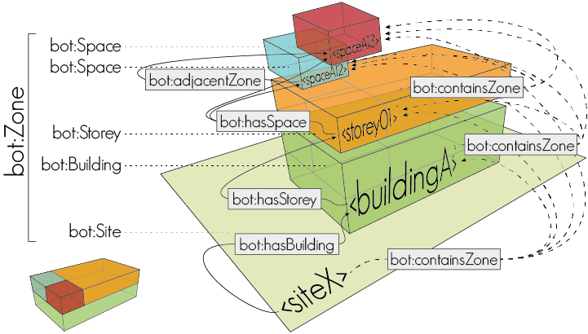
Building Topology Ontology BOT
@prefix bot: <https://w3id.org/bot#>
bot:Site
bot:hasBuilding
bot:Building
bot:hasStorey
bot:Zone
bot:Storey
bot:hasSpace
bot:Space
bot:hasElement
bot:Element
bot:hasSubElement

Slide 81
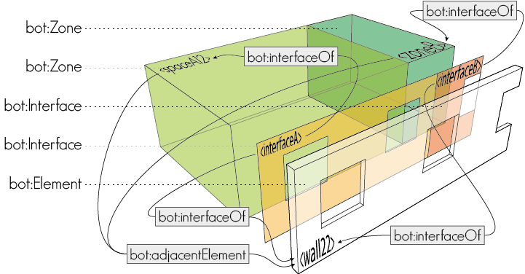
Building Topology Ontology BOT
@prefix bot: <https://w3id.org/bot#>
bot:interfaceOf
bot:Zone
bot:Interface
bot:hasElement
bot:Element
bot:interfaceOf

Slide 82
We can extend BOT with other modular ontologies
bot:Site
a:Geometry
c:City
bot:hasBuilding
bot:Building
bot:hasStorey
d:ThermalInsulation
b:LectureRoom
bot:Storey
bot:hasSpace
d:Wall
g:Temperature
bot:Space
bot:hasElement
e:Damage
f:Sensor
bot:Element

Slide 83
We can extend BOT with other modular ontologies
bot:Site
a:Geometry
bot:hasBuilding
bot:Building
bot:hasStorey
bot:Storey
bot:hasSpace
bot:Space
bot:hasElement
bot:Element

Slide 84
Ontology for Managing Geometry OMG
@prefix omg: <https://w3id.org/omg#>
<object>
omg:Geometry
“”^^geo:wktLiteral
omg:hasGeometry
omg:hasSimpleGeometryDescription

Slide 85
Combining ontologies
bot:Building
Combine BOT and OMG using an object property omg:hasGeometry
bot:hasStorey
bot:Storey
bot:hasSpace
bot:Space
bot:hasElement
bot:Element
omg:Geometry
“”^^geo:wktLiteral
omg:hasGeometry
omg:hasSimpleGeometryDescription

Slide 86
Common Linked Building Data ontologies
Buildings: BOT, DogOnt, SAREF4BLDG, REC, ifcOWL
Element taxonomies: BEO
Properties: OPM, BOP
Sensors: SOSA/SSN, SAREF, SEAS, BOP
Geometry: OMG, GeoSPARQL, GOM, FOG
HVAC: Brick
Provenance, metadata: PROV-O, DCAT, DublinCore
… and many, many more!

Slide 87
Creating an RDF TTL file

Slide 88
Interaction

Slide 89
Web-based BIM
Decoupling enables software developers to build multiple applications on top of the same data. Let’s test some of those!
MyHouse.ifc
Window
Height: 1200 mm
Width: 600 mm

Slide 90
Some online available tools
LBDviz
HeritageLBDviz
LD-BIM (Rasmussen & Schlachter)
Loki (Kadaster)

Slide 91
Large Language Models
Machine learning models that are designed for natural language processing tasks, typically pretrained on massive datasets. Examples:
GPT
Claude Sonnet
Gemini
Grok
Each excels in different tasks. Difficult to pick a winner.
Note that the ‘old-school’ Natural Language Processing tools such as SpaCy are still there.

Slide 92
Can we combine graphs and LLMs?
Artificial Intelligence
Machine Learning
Deep Learning
Natural Language Proccessing
GenAI
LLM
RAG
Symbolic AI

Slide 93
Some ideas
Graph creation
SPARQL generation
GraphRAG

Slide 94
Let’s try
Take a text in natural language, and prompt it to one of the LLMs. Ask to convert it to a TTL format. (zero-shot prompting)
Then add the TTL that you already created to the LLM, and ask to convert the text a TTL format following the similar logic as that manually created TTL. (one-shot prompting)
Then add the ontology that you created, and ask the LLM to map terms to those classes.

Slide 95
Let’s try
Write a question to the LLM in natural language and ask if it can convert it to SPARQL. Test it in GraphDB.

Slide 96
Recap
Block 1
The Semantic Web and Linked Building Data
Block 2
Ontologies
Block 3
Interaction

Slide 97
Web-based BIM
BILT Academy, 22-04-2025
Alex Donkers, Postdoctoral researcher
Information Systems in the Built Environment, Department of the Built Environment

